Slide 1
I agree to the Terms and Conditions.
(Please Refer to the T&C Document shared to SRM, before proceeding)

Slide 2




PROBLEM STATEMENT
TITLE
TEAM NAME & MEMBERS
…
…
…
…
PROPOSED SOLUTION
…
WHY THIS SOLUTION
TECHNOLOGY & TOOLS
…
…

Slide 3
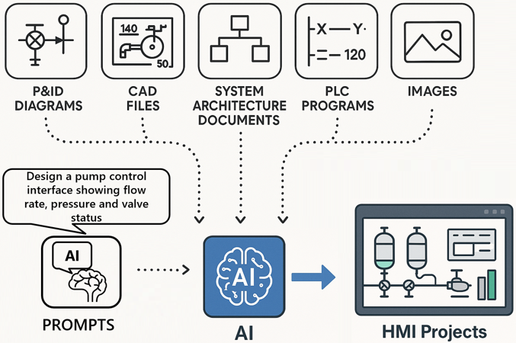
PROBLEM STATEMENT
TITLE
TEAM NAME & MEMBERS
<Put the problem statement you chose>
<Zenith>
<e.g. An Agent for the software>
<Asha, Nithin, Deepak>
PROPOSED SOLUTION
<Describe your proposed solution here. Add diagrams & pictures, if necessary, as shown>
WHY THIS SOLUTION
TECHNOLOGY & TOOLS
<Lists the technologies and tools you will use to implement the solution> e.g Python, Docker etc.
<Explain the reason for choosing the solution you proposed. Highlight unique abilities and competitive edge>

